Slide 1
Capstone update-First phase
20200511

Slide 2
Progress update
First phase:
Peak picking & assessment
Alignment & summary
Preliminary workflow integration ← Current place
Second phase:
Clustering brainstorm & algorithm development
Establishment of the dilution prediction model
Multiple source tracking workflow development
Third phase:
Code testing, debugging and pack up for different versions towards user needs
Add more features

Slide 3
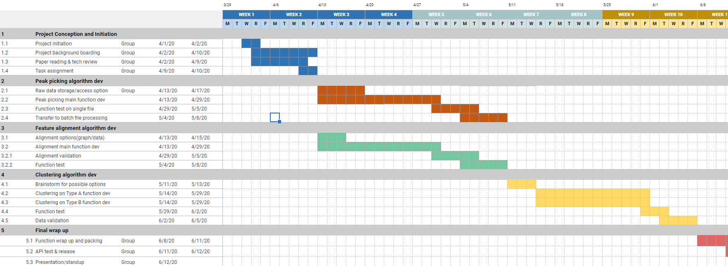
Progress update

Slide 4
Peak picking
Mzml file import
Mainly based on pymzml package, which provided a high efficiency access to the raw data even during iterations
Raw data cleaning
MS1/MS2 scan selection
Peak picking & peak table export
Mainly based on peakUtils package – similar to scipy.signal package
Noise removal
Utilized DNN model developed from TF to assess the peaks
In the export peak table, also added modeling score for user to define if to retain the features
Single file/batch files option available

Slide 5
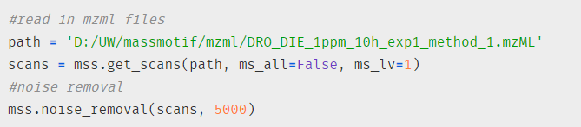
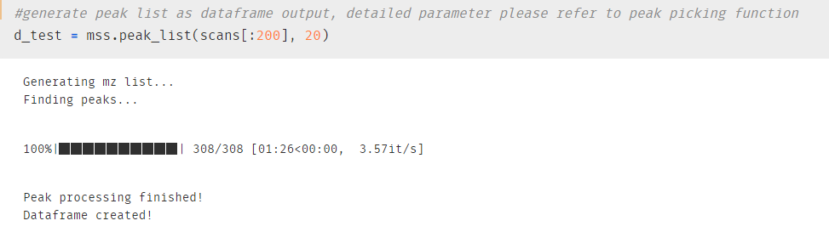
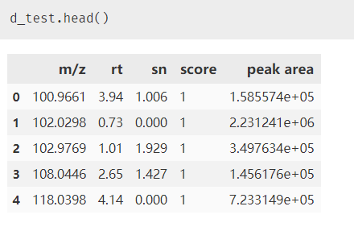
Sample output

Slide 6
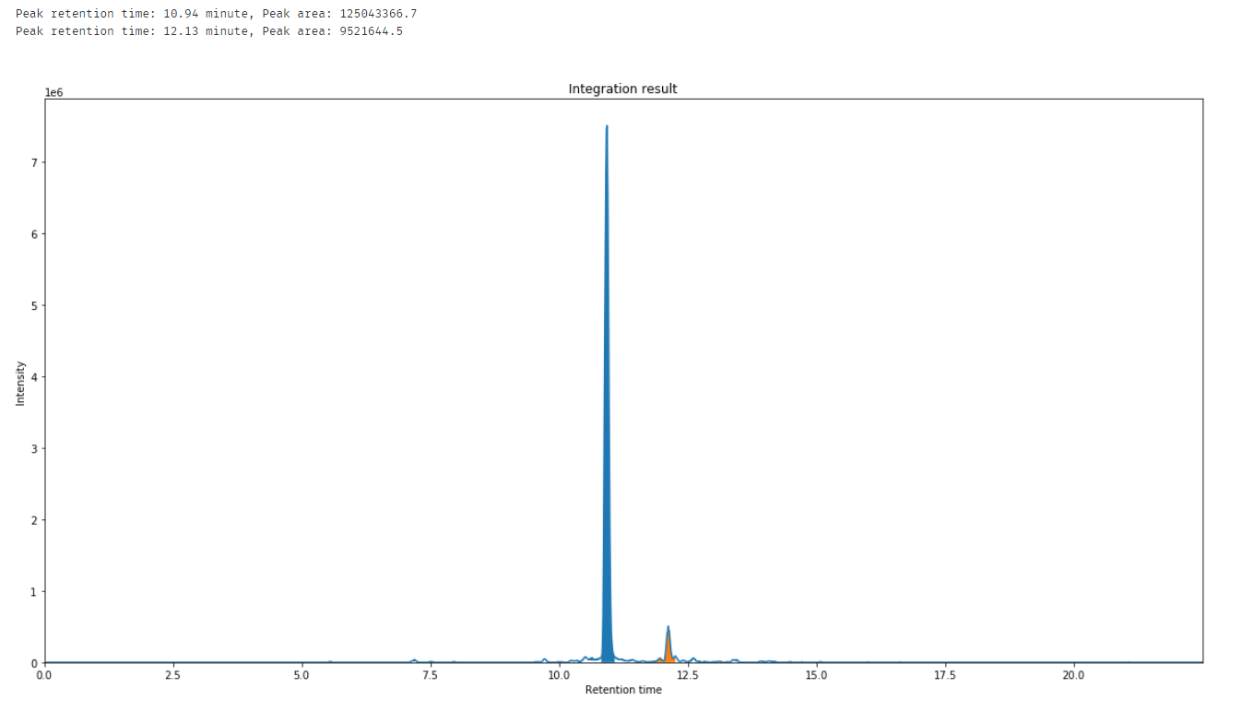

Slide 7
Alignment

Slide 8
Main features
General:
First package on python which provide full workflow from data import to alignment result comparing to other open source software for the MS data processing (pyteomics, pyopenms)
Light memory usage make it possible to be run on personal laptops (~2min per sample at 5000 noise threshold under current tests)
More customization space for user while still have the default ‘one click’ script
Peak picking
Boost up the large file processing time by pymzml port
Provide assessment scores to improve the data quality by user needs
Alignment

Slide 9
Next steps
Clustering algorithm development – second phase
Literature reviews – why to do and how to do
Algorithm development
Feature grouping algorithm
Prediction/source tracking model development
Validation and application – start from data at one place to create the ‘box’
Package development
Contribute the whole workflow as a user friendly and useful tools towards all MS users
Leave out spaces for further development and customization according to needs
Interactive

